Slide 1
ElecEng 458 - Computer Architecture
The Legal Stuff
Introductions
Textbook
Prerequisites
Grading and Rules
Introduction
Course Objectives
Topics and Lectures
Overview
Computing
History
Architecture

Slide 2
ElecEng 458 - The Legal Stuff
Introductions:
Instructor: Mark D. Fries
Phone: 785-5725 (work)
414-245-1607 (home)
Email: mark.fries@med.ge.com
Office: Room 742
Hours: 12:20 - 1:30 on T & Th
(others arranged by appointment - use email)
Class meets: 11:05 - 12:20 on T & Th
Textbook: Morris Mano, Computer System Architecture,
Prentice-Hall, 1993
Prerequisites: Basic introduction to computer organization and
assembly language programming or digital logic

Slide 3
ElecEng 458 - The Legal Stuff
Exams to be done individually and on the date given
-- No mercy grades
There will be at least several homework and one exam before the
last possible drop date
Class participation and attendance
Attendance is expected but not required
Participation will be encouraged -- public speaking is
necessary for career success
Feedback
Honest open feedback is expected

Slide 4
ElecEng 458 - The Legal Stuff
Grading policy
Homework: 10%
Exam #1: 25%
Exam #2: 25%
Final Exam: 40%
Grading is on a “curve”, with the following caveats:
Anyone who has an average of >= 90% will receive an ‘A’
Anyone who has an average of < 60% will receive an ‘F’
There are no labs or programming assignments
Homework will be given at the end of each lecture.
It will be collected at the beginning of the next lecture
It will be graded and returned at the beginning of each week’s
Tuesday lecture

Slide 5
Course Objectives
Give students insite and understanding of:
Logical organization of computer systems
Design techniques for implementing subsystems
including arithmetic and logical units, control
units, memory, and I/O devices
Major architectural features of modern computer
systems

Slide 6
Topics and Lectures
1. Introduction 1 lecture
2. Digital Logic Circuits and Components 1-2 lectures
3. Number Systems 1-2 lectures
4. Register Transfer Language and Micro-Ops 1 lecture
5. Basic Computer Organization and Design 5 lectures
6. Microprogrammed Control Unit Design 3 lectures
7. Central Processing Unit (CPU) Design 2 lectures
8. Pipeline and Vector Processing 2 lectures
9. Computer Arithmetic Unit Design 2 lectures
10. Input / Output Organization 2 lectures
11. Memory Organization and Design 3 lectures
12. Multiprocessor Design 2 lectures
13. Computer Systems Performance Evaluation 1 lecture
14. Fault Tolerance and Reliability 1 lecture
If we have time !!!

Slide 7
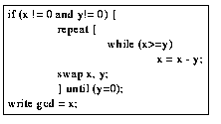
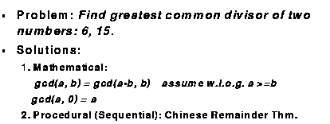
What Is Computing?

Slide 8
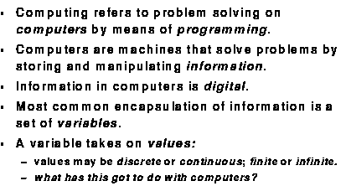
What Is Computing?

Slide 9
What Is A Computer?
Historically, a computer was a job title, not a piece of equipment!
Requirements of a computer:
Process data
Store data
Move data between the computer and the outside
world
Control the operation of the above

Slide 10
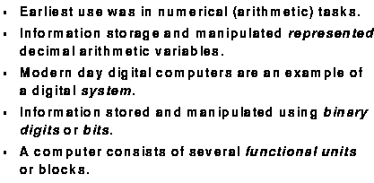
Historical Background

Slide 11
Computer History-Mechanical Era (1600-1940)
Wilhelm Schickhard (1623)
Astronomer and mathematician
Automatically add, subtract, multiply, and divide
Blaise Pascal (1642)
Mathematician
Mass produced first working machine (50 copies)
Could only add and subtract
Maintenance and labor problems
Gottfried Liebniz (1673)
Mathematician and inventor
Improved on Pascal’s machine
Add, subtract, multiply, and divide

Slide 12
Computer History-Mechanical Era (1600-1940)
Charles Babbage (1822)
Mathematician
“Father of modern computer”
Wanted more accuracy in calculations
Difference engine
Government / science agreement
Automatic computation of math tables
Analytic engine
Perform any math operation
Punch cards
Modern structure: I/O, storage, ALU
Add in 1 second, multiply in 1 minute
Both engines plagued by mechanical problems
George Boole (1847)
Mathematical analysis of logic
Investigation of laws of thought

Slide 13
Computer History-Mechanical Era (1600-1940)
Herman Hollerith (1889)
Modern day punched card machine
Formed Tabulating Machine Company (became IBM)
1880 census took 5 years to tabulate
Tabulation estimates
1890: 7.5 years
1900: 10+ years
Hollerith’s tabulating machine reduced the 7.5 year estimate
to 2 months
Konrad Zuse (1938)
Built first working mechanical computer, the Z1
Binary machine
German government decided not to pursue--W.W.II already started
Howard Aiken (1943)
Designed the Harvard Mark I
Implementation of Babbage’s machine
Built by IBM

Slide 14
Computer History - Electronic Era (1940- )
Generation 1 (1945 - 1958) – ENIAC
Developed for calculating artillery firing tables
Designed by Mauchly&Echert of the University of Pennsylvania
Generally regarded as the first electronic computer
BIG!
18,000 tubes
70,000 resistors
10,000 capacitors
6,000 switches
30 x 50 feet
140 kW of power
Decimal number system used
Programmed by manually setting switches

Slide 15
Computer History - Electronic Era
Generation 1 – IAS (Institute for Advanced Studies)
von Neumann and Goldstine
Took idea of ENIAC and developed concept of storing
a program in the memory
This architecture came to be known as the “von
Neumann” architecture and has been the basis for
virtually every machine designed since then
Features
Data and instructions (programs) are stored in
a single read-write memory
Memory contents are addressable by location,
regardless of the content itself
Sequential execution

Slide 16
Computer History - Electronic Era
Generation 2 (1958 - 1964)
Technology change -- Transistors
High level languages
Floating point arithmetic
Generation 3 (1964 - 1974)
Introduction of integrated circuits
Semiconductor memory
Microprogramming
Multiprogramming
Generation 4 (1974 - present)
Large scale integration / VLSI
Single board computers
Generation 5 (? - ?)
VLSI / ULSI
Computer communications networks
Artificial intelligence
Massively parallel machines

Slide 17
Performance Trends
Processor
Logic capacity: increases about 30% per year
Clock rate: increases about 20% per year
Performance: increases about 50% per year
Memory
DRAM capacity: increases about 60% per year (4x every 3
years)
Performance: increases about 3.4% per year
Disk
Capacity: about 60% per year
Performance: increases about 3.4% per year
What impact does this have on future computer systems?
What impact does this have on design decisions?

Slide 18
Performance Trends
Supercomputers
Mainframes
Minicomputers
Log of Performance
Microprocessors
Y
ear
1970
1975
1980
1985
1990
1995

Slide 19
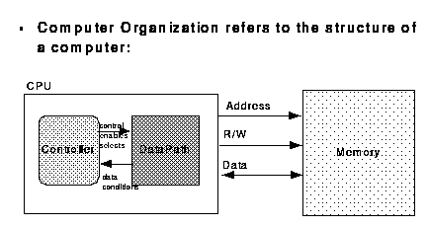
Computer Architecture (or Organization)

Slide 20
What is Computer Architecture?
Baer: “The design of the integrated system which provides a useful tool to the programmer”
Hayes: “The study of the structure, behavior and design of computers”
Abd-Alla: “The design of the system specification at a general or subsystem level”
Foster: “The art of designing a machine that will be a pleasure to work with”
Hennessy and Patterson: “The interface between the hardware and the lowest level software”

Slide 21
Common themes
Design / structure
Art
System
Tool for programmer and application
Interface
Thus, computer architecture refers to those attributes of the system that are visible to a programmer -- those attributes that have a direct impact on the execution of a program
Instruction sets
Data representations
Addressing
I/O

Slide 22
Computer Organization
Synonymous with “architecture” in many uses and textbooks
We will use it to mean the underlying implementation of the architecture transparent to the programmer
An architecture can have a number of organizational implementations
Control signals
Technologies
Device implementations

Slide 23
Four Levels of Computer Description
Global system structure
Overall system structure is defined
Major components identified
Processors
Control modules
Memory modules
Interconnection structure
Mostly a static description -- “black box” approach
Processor level
Architectural Features specified
Interfaces
Instruction sets
Data Representation
More detailed individual component specification

Slide 24
Four Levels of Computer Description
Register level
Specify internal operation of processor-level
components at the word level
Primitives:
Registers
Counters
Memories
ALUs
Clocks
Combinational logic
Gate level
Specify operations at the individual bit level
Gates are primitive elements
Very cumbersome to do manually (logic
minimization, etc.)

